Slide 2
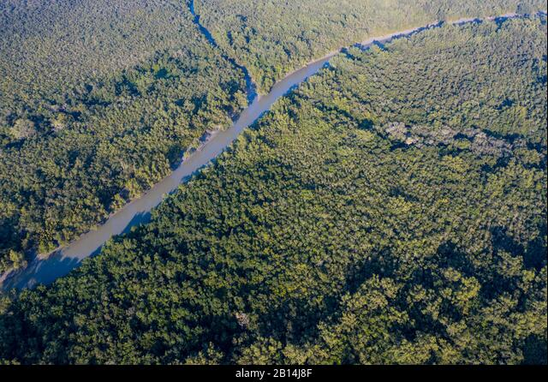
Title of the Study
The Economic Impact of Tropical Storms on the Sundarban's Mangrove Ecosystem Services and Local Communities.
2

Slide 3
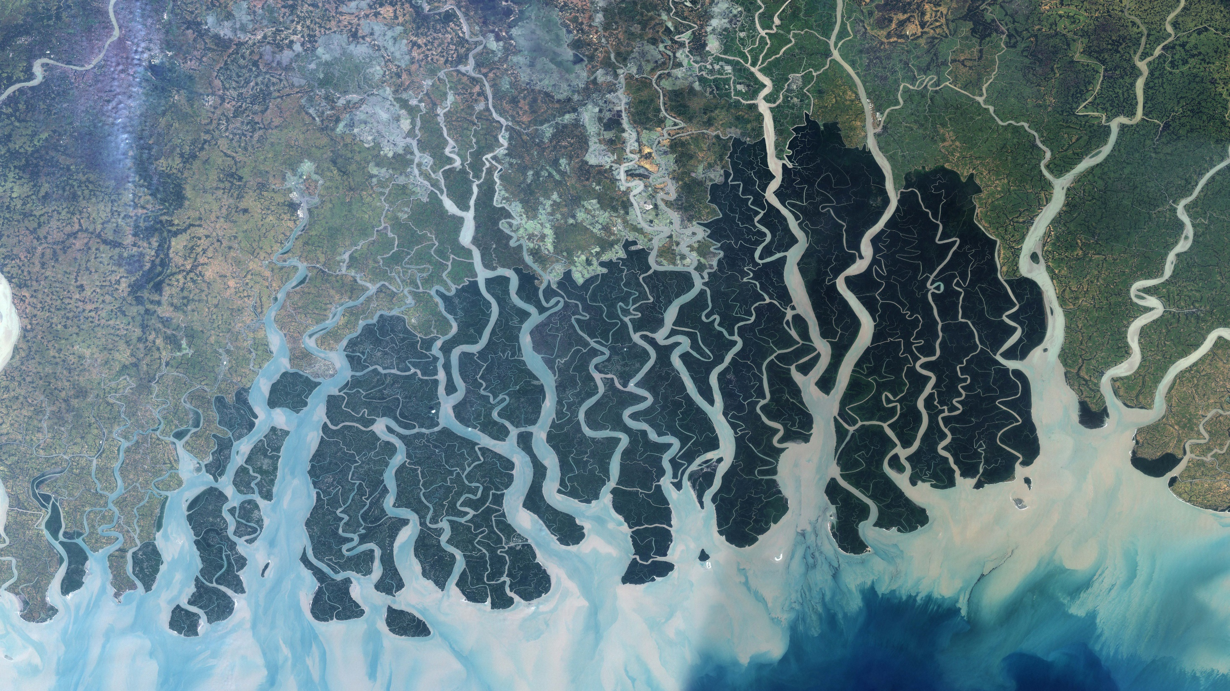

What is the first thing that comes to our mind when we hear about Sundarbans?
3

Slide 4
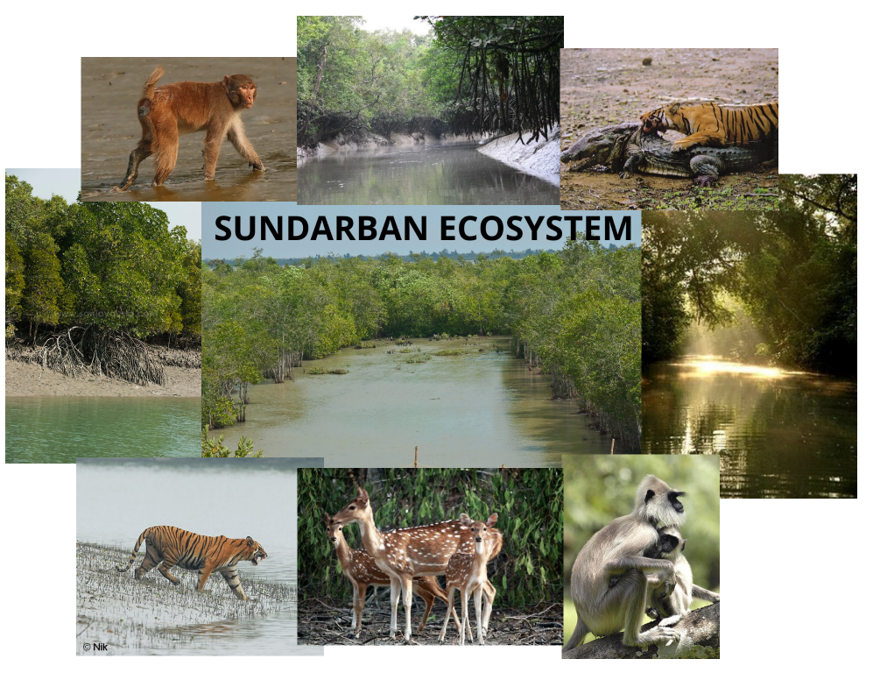
Sundarbans Ecosystem
Mangrove forests
Estuaries and tidal creeks
Wildlife
Human communities
Rivers
Biodiversity
Coastal zones
Fisheries
Trees
5
Source: Google

Slide 5
Ecosystem Services
Provisional Services
Regulatory Services
Supporting Services
Cultural Services
Timber
Fish
Crab
Fuel Wood
Thatching Materials
Honey and Wax
Climate Regulation
Disease Regulation
Water Regulation
Water Purification
Soil Formation
Nutrient Cycling
Primary Production
Spiritual and religious
Tourism and aesthetic
Educational
Cultural Heritage
6

Slide 6
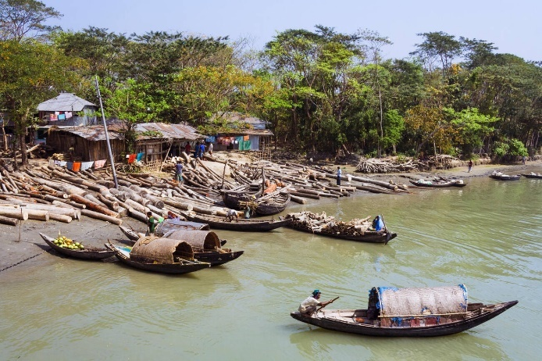
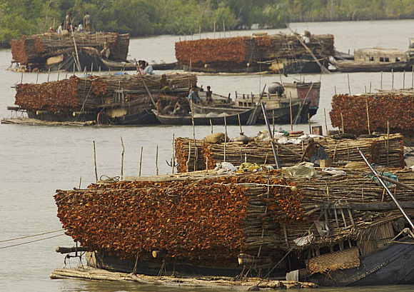
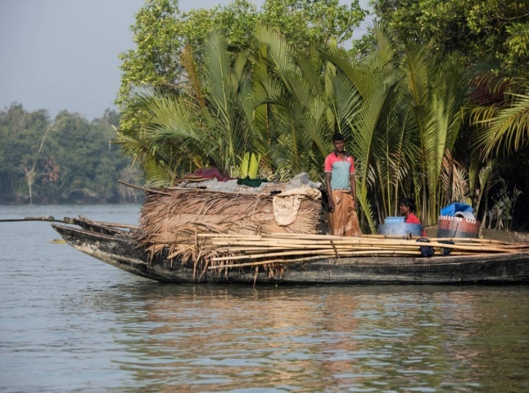
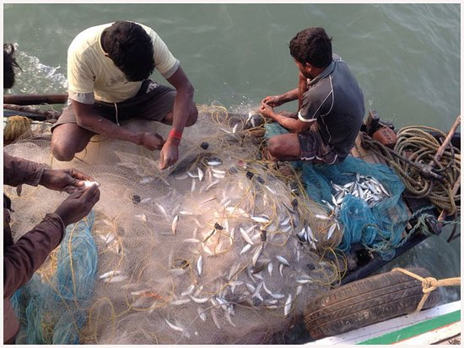
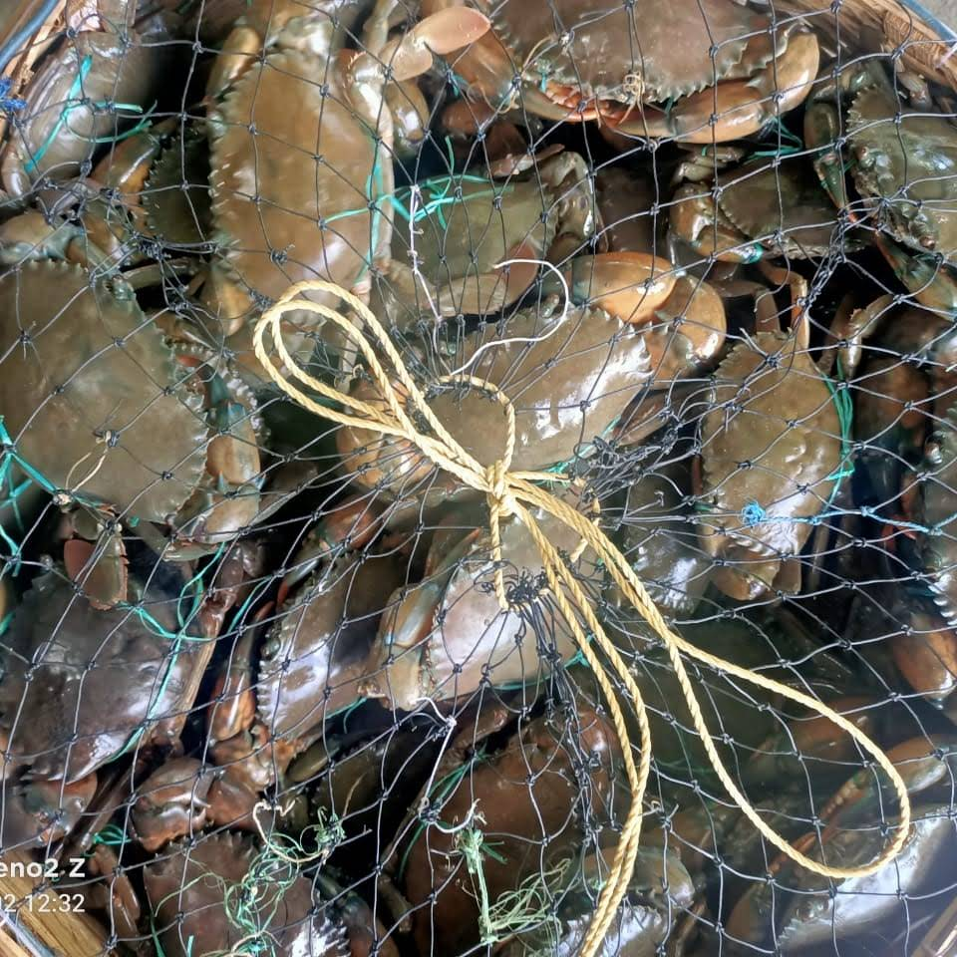
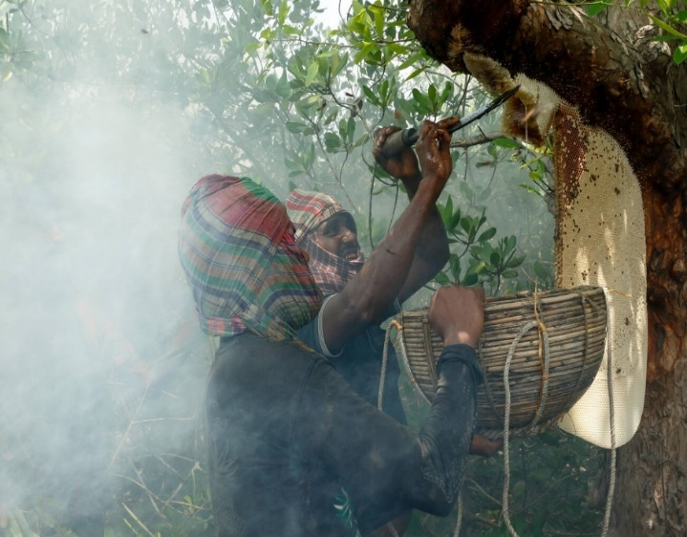
Provisional Ecosystem Services
Timber of Sundari, Keora, Passur, Gewa
Fuel Wood (Goran)
Thatching Material (Golpata,Shan)
Fishing in Sundarbans
Crab
Honey and Wax
7
Source: Google

Slide 7
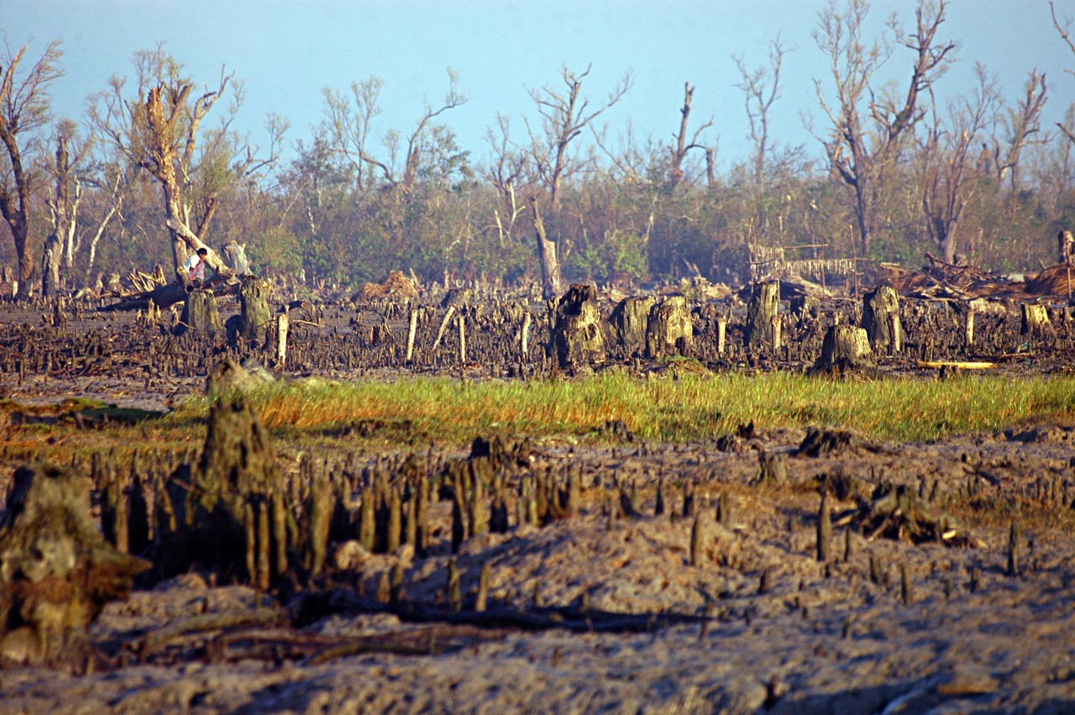
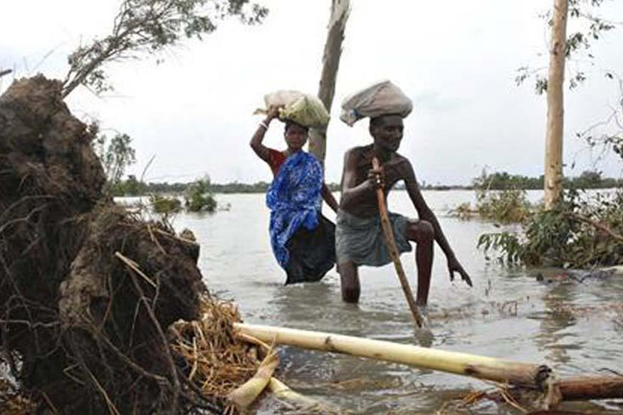
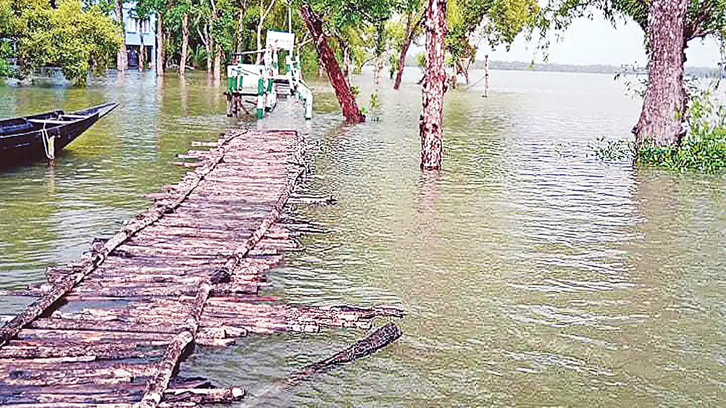
Tropical Storms
Sidr in 2007 degraded 25-40% of the forest area further stress to the biodiversity of Sundarbans
In 2009 Cyclone Aila devastated the Sundarbans at least 100,000 people were affected by this cyclone.
Cyclone
In a worst case scenario 32 cm of SLR may flood 84% of Sundarbans possibly by 2050.
Flood
10 cm SLR will inundate 15% of the Sundarbans
25 cm SLR will inundate 40% of the Sundarbans
8
Tidal Surge
Source: Google

Slide 8
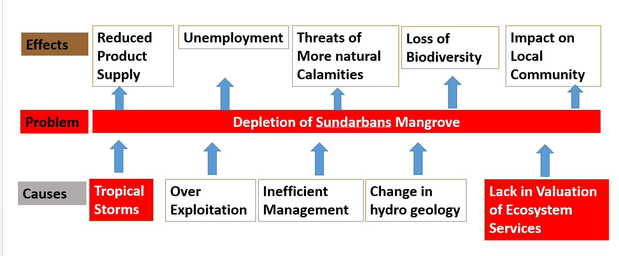
Problem Statement
Effects
9

Slide 9
Research Gap
The economic importance of the ecosystem services is always underestimated and there is lacking in valuation of ecosystem services.
In previous studies, the main importance was given in analyzing the impact of different disaster on the biodiversity of Sundarbans.
But the economic damage of the ecosystem services because of tropical storms is always underestimated and the impact of this economic damage of ecosystem services on the local community is always ignored.
And the sustainable common pool resource management is always absent as the steps taken to manage common pool resources results negatively.
10

Slide 10
Rational of the Study
To address the issue and management problems, information on economic values are important.
Ecosystem valuation is needed to separate the complexities of socio-ecological relationships.
To express these value changes in units monetary that allow for their incorporation in public decision-making processes.
To assess the effect of Tropical Storms on mangroves and the local community.
Ecosystem valuation helps convincing decision makers to take proper actions for conserving mangrove ecosystems.
A rough calculation of the ecosystem services and establishes a framework for further valuation.
12

Slide 11
Research Question, Research Hypothesis, Research Objectives
Research Question | Research Hypothesis | Research Objectives
1. What are the ecosystem services of Sundarbans. 2.What is the economic value of ecosystem services of Sundarban. | 1. The economic value of ecosystem services of Sundarban is so much. | 1. To assess the economic value of provisional ecosystem services of Sundarban.
1.Which tropical storms have significant effect on Sundarbans. 2. What are the economic losses of ecosystem services occurs due to tropical Storms. 3. What are the losses incurred to the local communities. | 1. The economic loss due the tropical storm is so much and the local communities also face significant loss. | 2. To quantify the economic losses of ecosystem services and losses incurred to the local communities due to tropical storms.
13

Slide 12
Research Question, Research Hypothesis, Research Objectives
Research Question | Research Hypothesis | Research Objectives
1. What is the condition of existing measures. 2. What can be the improved measures to reduce the open access problem. | 1. The improved and new strategies will help in reducing the open access problem. | 3. To evaluate the effectiveness of existing measures and to propose new strategies to manage the common pool resources in a sustainable way by local community.
15

Slide 13
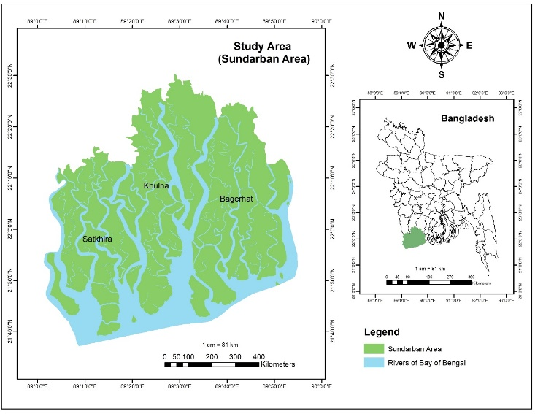
Study Area
16
Source: Google

Slide 14
Study Material
Approach and Methodology
Objectives | Data | Data Collection Method and Sources | Approach
To assess the economic value of provisional ecosystem services of Sundarban. | Provisional Ecosystem Services Economic Valuation | Official Record of Forrest data IUCN, IPAC, BIPS, CEGIS, BWBD | Direct Valuation Method Market Price Method
To quantify the economic losses of ecosystem services and losses incurred to the local communities due to tropical storms. | Tropical Storms Impact on ecosystem services Impact on Community | Official Record of Forrest data Article, Journals QS, FGD, KII | Direct Valuation Method Indirect Valuation Method
To evaluate the effectiveness of existing measures and to propose strategies in managing the common pool resources in a sustainable way. | Existing Initiative Scope of improving Measures CPR Management | QS, FGD, KII Articles, Journals | Group Evaluation CPR management Localized CPR management

Slide 15
Study Material
Objective Based Approach and Methodology
Valuation of Provisional Ecosystem Services
Economic impact of tropical storm on the services
Existing management and Improved CPR management
Selection of Provisional Ecosystem services
Collection of Data from Forrest Department
Market Price Method
Value (Taka) = Production (Total unit) × Unit Price − Production cost
Questionnaire Survey(80 collectors), FGD, KII
Analysis of the Yearly production
Analysis of Revenue / Effort data
Assess the effectiveness of CPRM policy
Localized CPR Management
Propose improved CPRM
Average Disturbance day * Average Quantity * Unit Price
Indirect Loss
Different between 1 week before and after storms
Long term impact
Impact=Value in different scenario(SLR, Land cover, Salinity)
Direct Loss
FGD, KII, Questionnaire analysis
IRMP, Articles
Scott & Gordon model
Ostrom Model
17

Slide 16
Results & Discussion
Economic Value of the Provisional Ecosystem services
Timber
Thatching Materials
Notes:
The avg annual revenue from timber is almost 0.67 million & The avg revenue for Thatching materials is 2.7 million

Slide 17
Results & Discussion
Economic Value of the Provisional Ecosystem services
Fish
Crab
Notes:
The avg annual revenue from Fish is almost 48.5 million & The avg revenue for Crab is 4.3 million

Slide 18
Results & Discussion
Economic Value of the Provisional Ecosystem services
Honey and Wax
Fuel Wood
Notes:
The avg annual revenue from Honey and wax is almost 1.6 & 0.6 million & The avg revenue for Fuel wood is 0.5 million

Slide 19
Results & Discussion
Quantify the impact of tropical storms on the ecosystem services
Direct Disturbance due to tropical storms
Difference in income before and after the storm
Notes:
Avg loss for fish 4620, for crab 2423, for honey 5546, fuel wood 3776 and goalpata 3795
Weekly income difference is almost 500 for fishers , 700 for crab collectors, 1000 for mawals

Slide 20
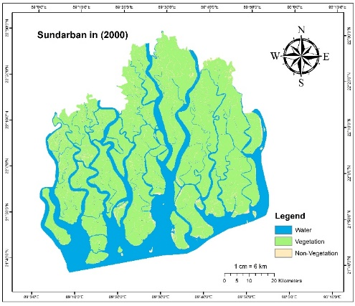
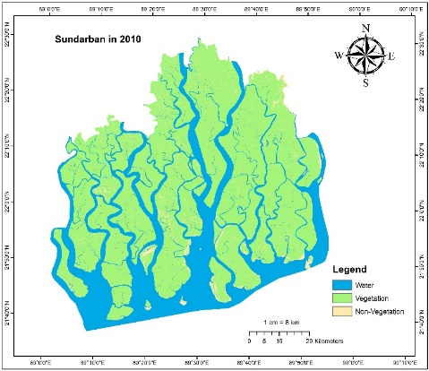
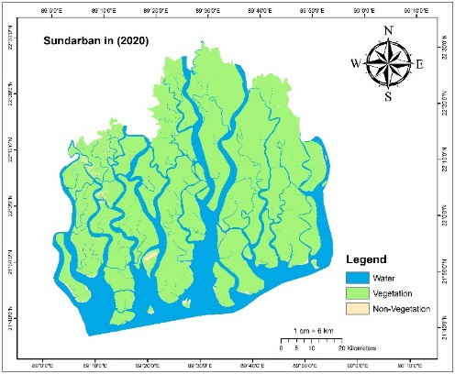
Results & Discussion
Quantify the impact of tropical storms on the ecosystem services
Long term impact : Change in Land Cover
Notes:
The land cover is changing day by day as the vegetation area decreasing and waterbody increasing. Water body increased almost 4% in 20 yrs

Slide 21
Results & Discussion
Quantify the impact of tropical storms on the ecosystem services
Long term impact: Tress in Sea Level Rise Scenario
Species | Year | SLR (cm) | Suitable area | Value(M us$)
Sunduri | 2001 | Base | 80489 | 402
 | 2050 | 32 | 69571 | 348
 | 2100 | 88 | 43884 | 219
Gewa | 2001 | Base | 59027 | 29
 | 2050 | 32 | 58992 | 28
 | 2100 | 88 | 55021 | 27
Notes:
In 2050 the sea level will rise 32 cm which will decrease the suitable area for sunduri and gewa respectively 10000 ha and in 2100 it will be 43884 ha
The economic value will decrease also. 50 m $ for sunduri in50 yr.

Slide 22
Results & Discussion
Quantify the impact of tropical storms on the ecosystem services
Positive impact on the Biodiversity
Fish stock increase due to off in extraction in tropical storm time can be estimated following this.
= Maximum extraction rate per fishers per day × number of fishers × Average disturbance day
= 2.79 kg * 50000 * 13
About maximum 1813.5 tons fish is estimated to be added in the total stock due to the barriers in extraction in the tropical storms days.
Like fish other species crab, timber species, thatching materials, bee hive will be increase in stock.

Slide 23
Results & Discussion
Sustainable Management of Common Pool Resources
Productivity Carrying capacity
8174
M
Population (tons)
Situation of the Provisional Services (FISH)
4000
0
Time (t)
Maximum Sustainable yield (MSY)
4421 tons
Population Growth
M
0
P
Population (tons)

Slide 24
Results & Discussion
Sustainable Management of Common Pool Resources
Population Growth
MSY (4421 m.tonne)
Proposed Maximum Sustainable yield
Q”
R2
Q’
R
Q
R1
MSY( 4421 ton)
R
Efficient MSY(4200 ton)
R’
O
P
P’
Population
Population Growth
(MSY)
Q”
R1
Population Growth
R
Population
Q’
R2
Q
R3
O
P2
P1
P
Population

Slide 25
Results & Discussion
Sustainable Management of Common Pool Resources
D1
D2
D3
D4
D5
D6
D7
D8
D9
D10
D11
Maximum Sustainable Revenue
E
334
Total Cost
Earning from catch (taka)
320 tk
167
Total Cost + Additional cost
Total Revenue
0
180
C’
Total Cost
Effort for fishing
167
C
Earning from catch ( taka)
E1
E2
Total Cost
E3
Revenue
E4
E5
Earning from catch
E6
Open access
0
Effort for fishing
Revenue
0
N
Effort (number of boats)

Slide 26
Results & Discussion
Sustainable Management of Common Pool Resources
A
B
Existing Quota System & Shared Quota System
Payment for permission
Payment for permission
O
E
E’
Quantity of fish
A
B
Quantity of fish
Payment for permission(7 tk/kg)
Payment for permission(7 tk/kg)
A
B
Payment for permission
Payment for permission
O
E
Quantity of fish
2.79 kg per day per person
Quantity of fish
2.79 kg per day per person
Quantity of fish
Quantity of fish

Slide 27
Results & Discussion
Sustainable Management of Common Pool Resources
Management for Timber species, Thatching materials and Fuel Wood.
Cutting Cycle
MSY
MSY
MSY
Volume of timber
Volume of timber
Volume of timber
0
5
0
5
0
5
Year
Year
Year

Slide 28
Results & Discussion
Sustainable Management of Common Pool Resources
Management for Timber species, Thatching materials and Fuel Wood.
Annual Allowable Cut
Species | AAC (V10/ha /year) | Estimated AAC (V10/ha/year) | Working Plan Suggested AAC | Removal of increment (cum)
Sundari | 0.62 | 143285 | 54000 | 82808
Gewa | 0.033 | 9887 | 53000 | 6081
Keora | 0.014 | 4424 | 29852 | -21308
Others | 0.143 | 33041 | 23000 | 12626

Slide 29
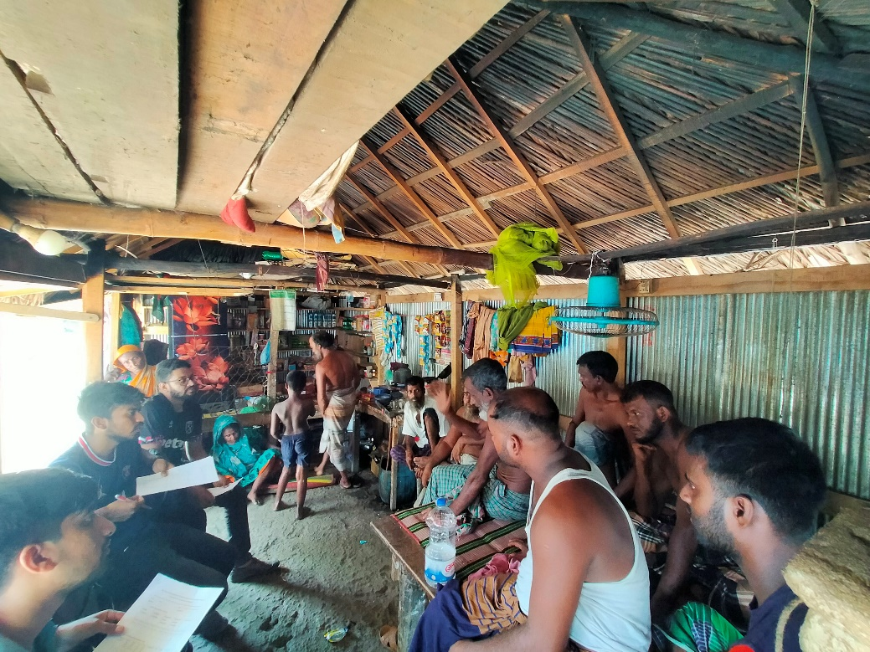
Results & Discussion
Sustainable Management of Common Pool Resources
Common Pool Resource Management By LOCAL COMMUNITY INVOLVEMENT
Clearly defined boundaries
Proportional equivalence
Participation
Conflict resolution
Graduated Sanctions
Monitoring
Recognition of rights
Nested enterprises

Slide 30
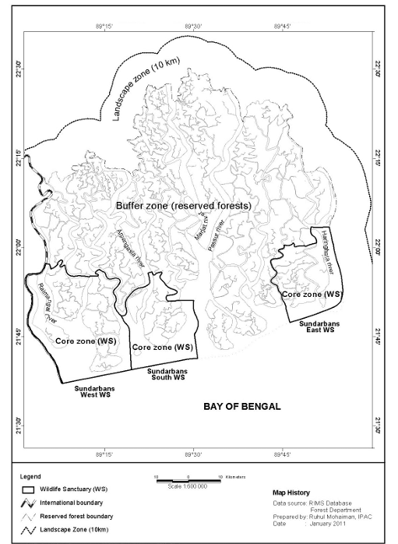
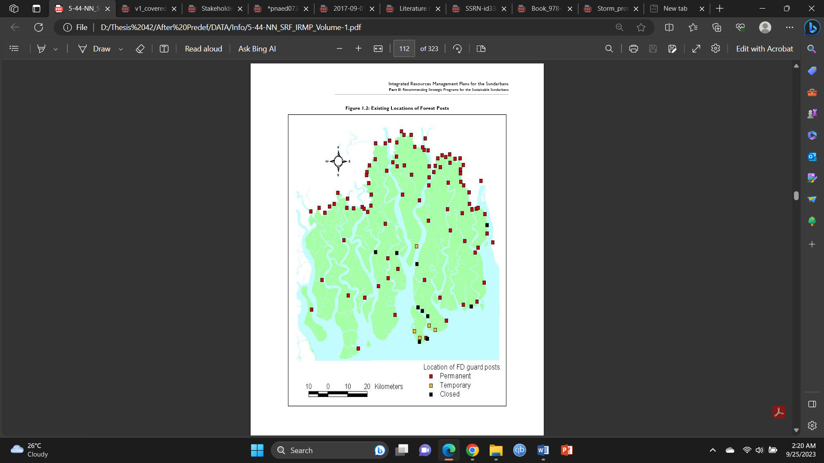
Results & Discussion
Sustainable Management of Common Pool Resources
By LOCAL COMMUNITY INVOLVEMENT
Clearly defined boundaries
Proportional equivalence
Participation
Monitoring
Incentive Alignment
Internalization of Costs
Revenue for Conservation
Balancing Resource Use
Reduction of Free Riding
Community-Based Resource Management
Flexibility and Adaptation
Equity and Fairness
Shared Knowledge and Expertise
Collaborative Rule-Making
Local Monitoring and Enforcement
Adaptive Management
Conflict Resolution
Resource Allocation
Capacity Building
Transparency and Accountability
Cross-Scale Governance

Slide 31
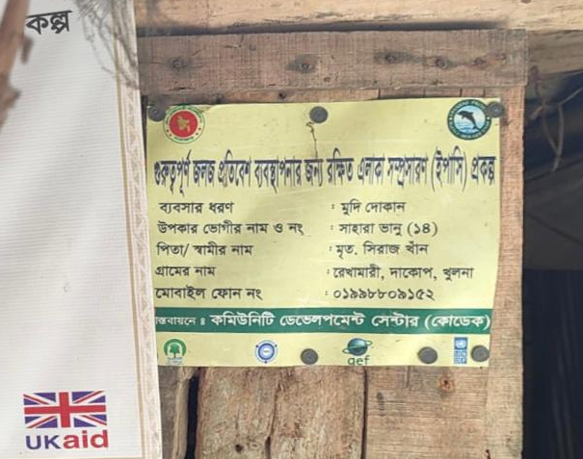
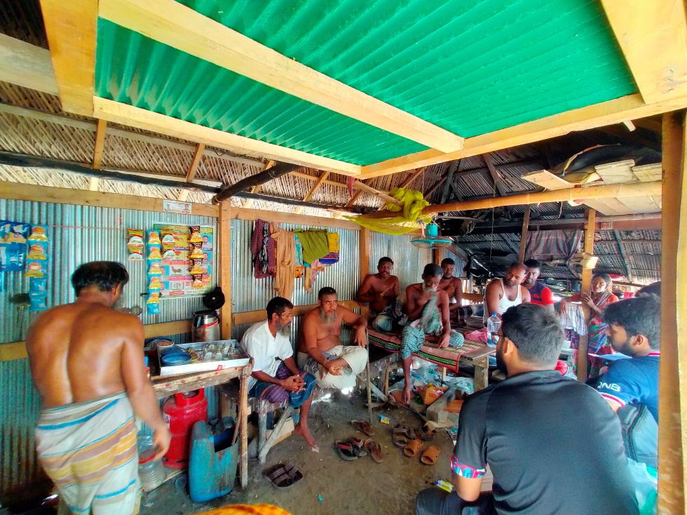
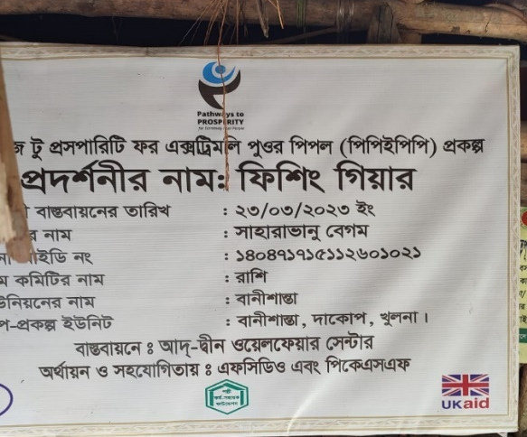
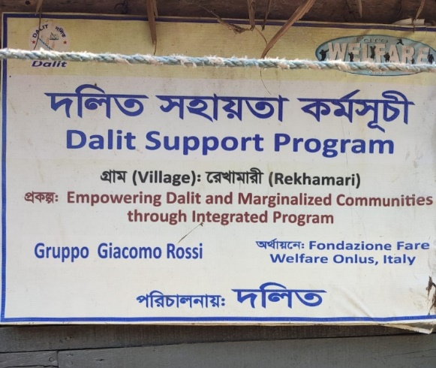
Results & Discussion
Sustainable Management of Common Pool Resources
Common Pool Resource Management By LOCAL COMMUNITY INVOLVEMENT
Conflict resolution
Graduated Sanctions
Nested enterprises
Fishing Net
Fishing Method
Time
Quantity
Area
User
Local
National
International
Recognition of rights

Slide 32
Key Findings
The average economic value of the provisional services of Sundarban is almost 65.86 million taka between the financial years 2010-2022.
The direct average economic loss occurs to the extractors are ranged between 4000 to 4500 taka for the fishers, 2000 to 2500 for the crab collectors, 5000 to 5500 taka for the honey collectors, 3500 to 4000 taka for the fire wood or thatching material collectors per storm.
Difference in the weekly income of the collectors before and after one week of the storm is a significant amount which is almost 500 taka for fishers and more than 1000 taka for mawals who collects honey and wax.
Long term effects SLR, Land Cover Change, Increase salinity will result depletion of the species due to less available suitable land and less sweet water.
The estimated MSY for fish which is almost 4421.2 tons. The estimated allowable cut for Sundari, Gewa, Keora is 143285,9887,4424 V10/ha/year and also there are regulations on the methods of extracting and time period of extraction.
Although all these initiative is for manage the growth rate, the yearly production represents other perspective.

Slide 33
Recommendation
The extraction of the services never exceed the MSY. Extraction should be stop if it reached the MSY.
As there are almost 23% illegal collectors , the MSY should be fixed in 4200 tons (where 5% illegal will not affect) and the BLC permit should be fixed on 95000 per year.
About 54% the fishers are willing to pay another 13 taka extra cost per trip to protect the biodiversity. If an individual fisher cost per trip is 167 taka then he should stop fishing at revenue 334 taka in respect of maximum sustainable revenue.
The shared quota system can be implemented among the fisherman. Among which the fisherman with less capable can shared a suitable portion of the quota to the fisherman who is more capable.
The working plan for annual allowable cut for Sundari, Gewa and Keora is respectfully 54000, 53000 and 29852 V10/ha/year.
Financial support from government and non-government organization should be provided to local people. Include local people in the policy making and alternative incoming opportunity creation for local community initiative should be taken.

Slide 34
Conclusive Remarks
Sundarban accounts for 40% of Bangladesh's forested land. Each hectare of SRF provides $793 in annual provisional services.
But over extraction due to inefficient management of the common pool resources will change the whole structure of the system.
All the management strategy is formulated in consideration of ensuring the maximum sustainable yield, maximum sustainable revenue, annual allowable cut, alternative incoming opportunities arrangement for local community.
The improved management policy is proposed with the experts and local communities from the Sundarban who are directly associated with the services of Sundarbans.
This study actually showed the importance of ensuring the sustainability of Sundarbans ecosystem services and expected to improve the livelihood of the local community by improving their livelihood socially and economically.

Slide 35
Reference
Ostrom, E. (1999). Coping with tragedies of the commons. Annual review of political science, 2(1), 493-535.
Pearce, D. W., & Pretty, J. N. (1993). Economic values and the natural world: Earthscan.
Pender, J. S. (2010). Climate change, its impacts and possible community based responses in Bangladesh: Church of Bangladesh Dhaka.
Pretty, J. (2003). Social capital and the collective management of resources. science, 302(5652), 1912-1914.
Quader, M. A., Agrawal, S., & Kervyn, M. (2017). Multi-decadal land cover evolution in the Sundarban, the largest mangrove forest in the world. Ocean & coastal management, 139, 113-124.
Rahman, M., & Begum, S. (2013). Land cover change analysis around the Sundarbans Mangrove Forest of Bangladesh using remote sensing and GIS application. Journal of Science Foundation, 9(1-2), 95-107.
Rahman, M. M., Rahman, M. M., & Islam, K. S. (2010). The causes of deterioration of Sundarban mangrove forest ecosystem of Bangladesh: conservation and sustainable management issues. Aquaculture, Aquarium, Conservation & Legislation, 3(2), 77-90.
Rahman, R. M., Asaduzzaman, M. (2010). ECOLOGY OF SUNDARBAN, BANGLADESH.
Sardar, P., & Samadder, S. R. (2021). Understanding the dynamics of landscape of greater Sundarban area using multi-layer perceptron Markov chain and landscape statistics approach. Ecological indicators, 121, 106914.
Sarhan, M., & Tawfik, R. (2018). The economic valuation of mangrove forest ecosystem services: implications for protected area conservation. Paper presented at the The George Wright Forum.
Spaninks, F., & Van Beukering, P. (1997). Economic valuation of mangrove ecosystems: potential and limitations.
Thakur, S., Maity, D., Mondal, I., Basumatary, G., Ghosh, P. B., Das, P., & De, T. K. (2021). Assessment of changes in land use, land cover, and land surface temperature in the mangrove forest of Sundarbans, northeast coast of India. Environment, Development and Sustainability, 23, 1917-1943.
Uddin, M. S. (2013). Economic valuation of Sundarbans mangrove ecosystems-Bangladesh: LAP Lambert Academic Publishing.
Vo, Q. T., Künzer, C., Vo, Q. M., Moder, F., & Oppelt, N. (2012). Review of valuation methods for mangrove ecosystem services. Ecological indicators, 23, 431-446.
Walton, M. E., Samonte-Tan, G. P., Primavera, J. H., Edwards-Jones, G., & Le Vay, L. (2006). Are mangroves worth replanting? The direct economic benefits of a community-based reforestation project. Environmental conservation, 33(4), 335-343.
Webber, M., Webber, D., & Trench, C. (2014). agroecology for Sustainable Coastal Ecosystems. Agroecology, Ecosystems, and Sustainability, 239.
WWF. (2017). Sundarban in a Global Perspective : Long Term Adaptation and Development - Discussion Paper (English). Washington, D.C. : World Bank Group.
McCay, B. J. (1990). Common Property Resources; Ecology and Community-Based Sustainable Development. In: JSTOR.
MEA. (2005). Ecosystems and human well-being (Vol. 5): Island press Washington, DC.
MoEF. (2009). Bangladesh Climate Change Strategy and Action Plan, 2009: Ministry of Environment and Forests, Government of the People's Republic of ….
Mondal, S. H., & Debnath, P. (2017). Spatial and temporal changes of Sundarbans reserve forest in Bangladesh. Environment and Natural Resources Journal, 15(1), 51-61.
Mooney, H., Cropper, A., & Reid, W. (2005). Confronting the human dilemma. Nature, 434(7033), 561-562.
Murtaza, M. (2001). Socio-Economic Baseline Study of the Impact Zone of the Sundarbans. Sundarbans Biodiversity Conservation Project Report. Forest Department, Government of Bangladesh Khulna, Bangladesh.

Slide 36
Reference
Akber, M. A., Patwary, M. M., Islam, M. A., & Rahman, M. R. (2018). Storm protection service of the Sundarbans mangrove forest, Bangladesh. Natural Hazards, 94, 405-418.
Akhtaruzzaman, A. (2004). Mangrove forestry research in Bangladesh. Mangrove management and conservation: present and future, 249-256.
Alley, R. B., Berntsen, T., Bindoff, N. L., Chidthaisong, A., Friedlingstein, P., Gregory, J. M., . . . Hoskins, B. J. (2007). Summary for policymakers. In.
Allison, E. H., & Horemans, B. (2006). Putting the principles of the sustainable livelihoods approach into fisheries development policy and practice. Marine policy, 30(6), 757-766.
Awty-Carroll, K., Bunting, P., Hardy, A., & Bell, G. (2019). Using continuous change detection and classification of Landsat data to investigate long-term mangrove dynamics in the Sundarbans region. Remote Sensing, 11(23), 2833.
Barbier, E. B. (1993). Sustainable use of wetlands valuing tropical wetland benefits: economic methodologies and applications. Geographical Journal, 22-32.
Barbier, E. B. (2003). Habitat–fishery linkages and mangrove loss in Thailand. Contemporary Economic Policy, 21(1), 59-77.
Barbier, E. B. (2008). Poverty, development, and ecological services. International Review of Environmental and Resource Economics, 2(1), 1-27.
Barbier, E. B., Georgiou, I. Y., Enchelmeyer, B., & Reed, D. J. (2013). The value of wetlands in protecting southeast Louisiana from hurricane storm surges. PloS one, 8(3), e58715.
Berkowitz, B. (2014). The state of Antigonon leptopus (Corallita) on St Eustatius in 2014. Unpublished report. STENAPA, Gallows Bay, St. Eustatius.
Dutta, P. K., & Sundaram, R. K. (1993). The tragedy of the commons? Economic Theory, 3, 413-426.
Ekka, A., & Pandit, A. (2012). Willingness to pay for restoration of natural ecosystem: A study of Sundarban mangroves by contingent valuation approach. Indian Journal of Agricultural Economics, 67(3).
Engel, S., Pagiola, S., & Wunder, S. (2008). Designing payments for environmental services in theory and practice: An overview of the issues. Ecological economics, 65(4), 663-674.
Ernst, J., & Ketner, P. (2007). Study on the ecology and possible control methods of the invasive plant species Antigonon leptopus (Corallita or Mexican Creeper). ABC Research, Wageningen, The Netherlands.
Gammage, S. (1994). Estimating the total economic value of a mangrove ecosystem in El Salvador. Report to the Overseas Development Administration of the British Government. London.
Giri, C., Pengra, B., Zhu, Z., Singh, A., & Tieszen, L. L. (2007). Monitoring mangrove forest dynamics of the Sundarbans in Bangladesh and India using multi-temporal satellite data from 1973 to 2000. Estuarine, Coastal and shelf science, 73(1-2), 91-100.
Glaser, M., Berger, U., & Macedo, R. (2003). Local vulnerability as an advantage: mangrove forest management in Pará state, north Brazil, under conditions of illegality. Regional Environmental Change, 3(4), 162-172.
Hardin, G. (1968). The tragedy of the commons: the population problem has no technical solution; it requires a fundamental extension in morality. science, 162(3859), 1243-1248.

Slide 37
Reference
BFD. (2010). Integrated resources management plans for the Sundarbans (2010–2020). In: Nishorgo Network, Forest Department, Government of Bangladesh Dhaka.
Biswas, S. R., Choudhury, J. K., Nishat, A., & Rahman, M. M. (2007). Do invasive plants threaten the Sundarbans mangrove forest of Bangladesh? Forest Ecology and Management, 245(1-3), 1-9.
CEGIS. (2009). Report on Cyclone Shelter Information for Management of Tsunami and Cyclone Preparedness. In: Centre for Environmental and Geographic Information Services, Ministry of ….
Chowdhury, M. S., & Hafsa, B. (2022). Multi-decadal land cover change analysis over Sundarbans Mangrove Forest of Bangladesh: A GIS and remote sensing based approach. Global Ecology and Conservation, 37, e02151.
Costanza, R., De Groot, R., Sutton, P., Van der Ploeg, S., Anderson, S. J., Kubiszewski, I., . . . Turner, R. K. (2014). Changes in the global value of ecosystem services. Global environmental change, 26, 152-158.
Daily, G. C. (1997). Nature's services: societal dependence on natural ecosystems: Island press.
Das, S. (1985). The mangroves and mangrove forests of Bangladesh. Mangrove silviculture division Bulletin.
Dasgupta, P., & McKenzie, E. (2020). The Dasgupta Review–Independent Review on the Economics of Biodiversity Interim Report. Retrieved from. www.gov.uk/officialdocuments. .
Dasgupta, S., Sobhan, I., & Wheeler, D. (2017). The impact of climate change and aquatic salinization on mangrove species in the Bangladesh Sundarbans. Ambio, 46, 680-694.
De Groot, R. S., Wilson, M. A., & Boumans, R. M. (2002). A typology for the classification, description and valuation of ecosystem functions, goods and services. Ecological economics, 41(3), 393-408.
DebRoy, P., & Jayaraman, R. (2012). Economic valuation of mangroves for assessing the livelihood of fisherfolk: a case study in India.
Iftekhar, M., & Islam, M. (2004). Degeneration of Bangladesh’s Sundarbans mangroves: a management issue. International Forestry Review, 6(2), 123-135.
Inskip, C., Ridout, M., Fahad, Z., Tully, R., Barlow, A., Barlow, C. G., . . . MacMillan, D. (2013). Human–tiger conflict in context: risks to lives and livelihoods in the Bangladesh Sundarbans. Human ecology, 41, 169-186.
IPAC. (2010). A Study of the Principal Marketed Value
Chains Derived from the Sundarbans Re
served Forest, Integrated Protected Area Comanagement (IPAC) Project, International
Resources Group (IRG), Washington DC.
IPCC. (2012). Summary for Policymakers. In: Managing the Risks of Extreme Events and
Disasters to Advance Climate Change Adaptation. In Planning for Climate Change (pp. 111-128): Routledge.
Iqbal, M. H. (2020). Valuing ecosystem services of Sundarbans Mangrove forest: Approach of choice experiment. Global Ecology and Conservation, 24, e01273.
Islam, M. R., Khan, M. N. I., Khan, M. Z., & Roy, B. (2021). A three decade assessment of forest cover changes in Nijhum dwip national park using remote sensing and GIS. Environmental Challenges, 4, 100162.

Slide 38
Reference
Dutta, P. K., & Sundaram, R. K. (1993). The tragedy of the commons? Economic Theory, 3, 413-426.
Ekka, A., & Pandit, A. (2012). Willingness to pay for restoration of natural ecosystem: A study of Sundarban mangroves by contingent valuation approach. Indian Journal of Agricultural Economics, 67(3).
Engel, S., Pagiola, S., & Wunder, S. (2008). Designing payments for environmental services in theory and practice: An overview of the issues. Ecological economics, 65(4), 663-674.
Ernst, J., & Ketner, P. (2007). Study on the ecology and possible control methods of the invasive plant species Antigonon leptopus (Corallita or Mexican Creeper). ABC Research, Wageningen, The Netherlands.
Gammage, S. (1994). Estimating the total economic value of a mangrove ecosystem in El Salvador. Report to the Overseas Development Administration of the British Government. London.
Giri, C., Pengra, B., Zhu, Z., Singh, A., & Tieszen, L. L. (2007). Monitoring mangrove forest dynamics of the Sundarbans in Bangladesh and India using multi-temporal satellite data from 1973 to 2000. Estuarine, Coastal and shelf science, 73(1-2), 91-100.
Glaser, M., Berger, U., & Macedo, R. (2003). Local vulnerability as an advantage: mangrove forest management in Pará state, north Brazil, under conditions of illegality. Regional Environmental Change, 3(4), 162-172.
Hardin, G. (1968). The tragedy of the commons: the population problem has no technical solution; it requires a fundamental extension in morality. science, 162(3859), 1243-1248.
Iftekhar, M., & Islam, M. (2004). Degeneration of Bangladesh’s Sundarbans mangroves: a management issue. International Forestry Review, 6(2), 123-135.
Inskip, C., Ridout, M., Fahad, Z., Tully, R., Barlow, A., Barlow, C. G., . . . MacMillan, D. (2013). Human–tiger conflict in context: risks to lives and livelihoods in the Bangladesh Sundarbans. Human ecology, 41, 169-186.
Kabir, M. H. (2012). Economic valuation of biodiversity and ecosystem services of the Sundarbans
in Bangladesh.
Kathiresan, K., & Rajendran, N. (2005). Coastal mangrove forests mitigated tsunami. Estuarine, Coastal and shelf science, 65(3), 601-606.
Krauss, K. W., & Ball, M. C. (2013). On the halophytic nature of mangroves. Trees, 27(1), 7-11.
Lele, S., Springate-Baginski, O., Lakerveld, R., Deb, D., & Dash, P. (2013). Ecosystem services: origins, contributions, pitfalls, and alternatives. Conservation and Society, 11(4), 343-358.
Mahadevia Ghimire, K., & Vikas, M. (2012). Climate change–impact on the Sundarbans, a case study. International Scientific Journal: Environmental Science, 2(1), 7-15.
Mandal, M. S. H., & Hosaka, T. (2020). Assessing cyclone disturbances (1988–2016) in the Sundarbans mangrove forests using Landsat and Google Earth Engine. Natural Hazards, 102, 133-150.

